Slide 1

AI Based Puzzle Solver
Student information:
Mahady Hasan Fahim
221002469

Slide 2
Table of Content
Introduction
What is the 8 Puzzle?
Core Components
Logical diagram
Python Classes and Variables
Breadth-First Search (BFS)
Example Run
Conclusion

Slide 3
8 Puzzle Solver Using BFS
Python Implementation
Solve 8-puzzle with Breadth-First Search (BFS)

Slide 4
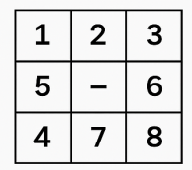
What is the 8 Puzzle?
3x3 grid with tiles numbered 1–8 and one empty space (0)
Goal: Move tiles to reach the target configuration.

Slide 5
Core Components
Key Concepts:
State: Current puzzle arrangement
Goal State: Target arrangement
Moves: Up, Down, Left, Right
BFS Algorithm: Explore all possible moves level-by-level

Slide 6
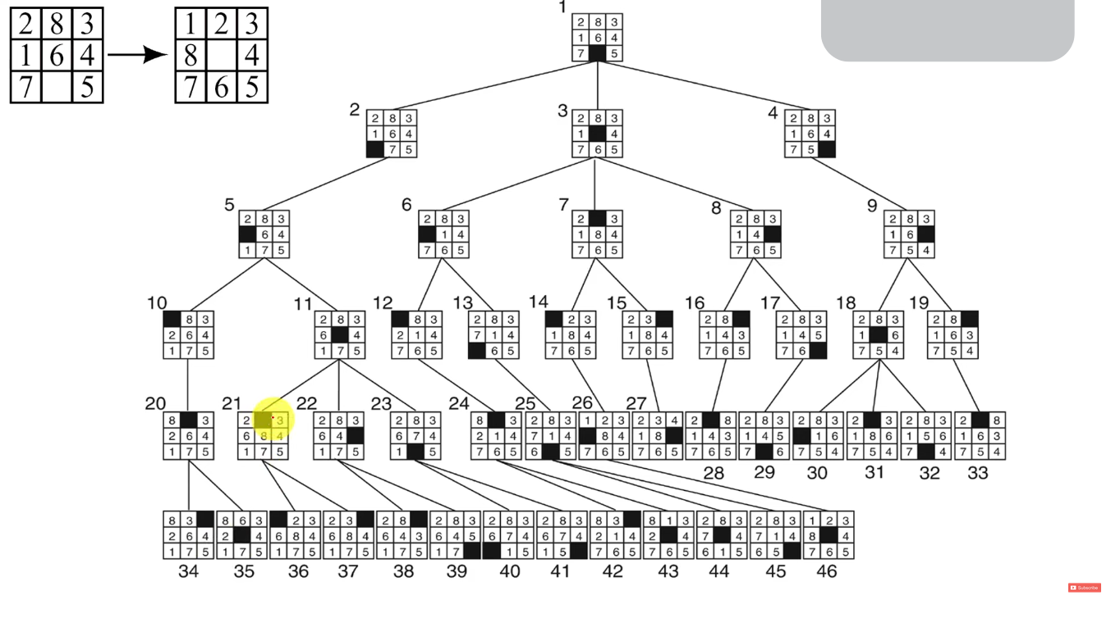
Logical diagram

Slide 7
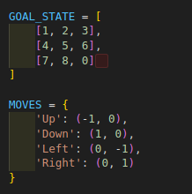
Python Classes and Variables
Global Variables:

Slide 8
Python Classes and Variables
PuzzleSolver Class
__init__: Initialize with start state
is_goal(state): Check if goal is reached
find_zero(state): Find empty space position
generate_neighbors(state): Create possible next moves

Slide 9
Breadth-First Search (BFS)
- Use Queue for exploration
- Track visited states
- Stop when goal is found
- Return list of moves

Slide 10
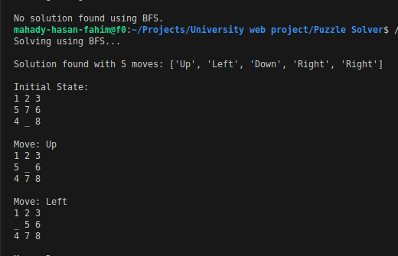
Example Run

Slide 11
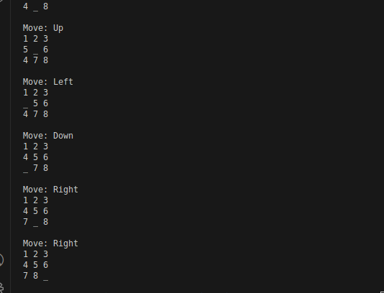
Example Run

Slide 12
Conclusion
We successfully solved the 8-puzzle using Breadth-First Search (BFS).
The algorithm systematically explores all possible moves to find the shortest solution path.
The solution is visualized step-by-step, making it easier to understand each transition.

Slide 13
Thank You

